Slide 1
OA3103: Data Analysis
CDR Paolo “Schwarma” Singh, USN
CDR Paolo “Schwarma” Singh, USN, PhD

Slide 2
Welcome to Data Analysis
Statistical modeling (statistical learning) class
Bridges what you learned in OA3101/3102
Tools for advanced methods leading to Machine Learning (OA4106/4118)

Slide 3
Data?
What is data?
Examples?
Input vs Output (response) variables
$$Y=f(x)=β_{0}+β_{1}x_{1}+β_{2}x_{2}$$
$$Y=f(x)=β_{0}+β_{1}x_{1}+β_{2}x_{2}+ε$$
Notes:
1. Data
You can point to each piece:
$x_{1},x_{2}$: observed inputs
$Y$: observed output
$ε$: unobserved noise
Then ask:
“Which of these do we actually get to see? Which do we never see?”
This immediately grounds the course in the reality of data work.

Slide 4
Inference vs Prediction
So far we’ve probably done a lot with inference
Given input variables/parameters, what can we say about certain parameters and their effect on the output?
Examples?
$$Y=f(x)=β_{0}+β_{1}x_{1}+β_{2}x_{2}+ε$$
Notes:
2. Inference
Inference is about the parameters:
What is $β_{1}$?
What is $β_{2}$?
Are they positive? Negative? Zero?
How certain are we?
What assumptions do we need?
You can say:
“Inference is about learning the structure of the world.”
This is the OA3102 → OA3103 bridge.

Slide 5
Prediction
Given input variables, what can we expect the output variable to be?
Examples?
$$Y=f(x)=β_{0}+β_{1}x_{1}+β_{2}x_{2}+ε$$
Notes:
3. Prediction
Prediction is about the output:
Given new $x_{1},x_{2}$, what do we expect $Y$to be?
How accurate can we be?
How much uncertainty remains?
What happens when the model is wrong?
You can say:
“Prediction is about learning what will happen next.”
This is the OA3103 → OA4106 bridge.

Slide 6






Regression and Classification
Regression
Classification
$$y$$
$$x_{2}$$
$$y$$
$$0 1$$
$$x$$
$$x_{1}$$
Source: An Intro to Spectral Convolution Neural Networks by Dr. Patrick McClure

Slide 7







Model: Linear
Regression
Linear Regression Model
Classification
Logistic Regression Model
$$y$$
$$x_{2}$$
$$y$$
$$0 1$$
$$x$$
$$x_{1}$$
$$p\left(y=1 | x\right)=sigmoid\left({w_{1}x}_{1}+{w_{2}x}_{2}+b\right)=\frac{1}{1+e^{{w_{1}x}_{1}+{w_{2}x}_{2}+b}}$$
$$\hat{y}=wx+b$$
Source: An Intro to Spectral Convolution Neural Networks by Dr. Patrick McClure

Slide 8
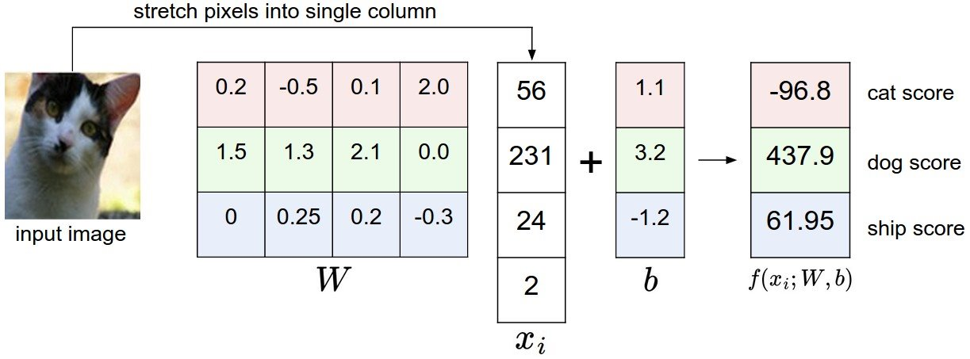

Model: Linear Classification
cat logit
dog logit
ship logit
Source: An Intro to Spectral Convolution Neural Networks by Dr. Patrick McClure

Slide 9
Data: Non-linear
Regression
Classification
$$y$$
$$x_{2}$$
$$y$$
$$0 1$$
$$x$$
$$x_{1}$$
Source: An Intro to Spectral Convolution Neural Networks by Dr. Patrick McClure

Slide 10

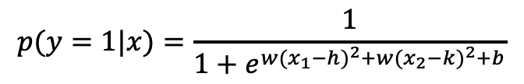
Model: Non-linear
Regression
Classification
$$y$$
$$x_{2}$$
$$y$$
$$0 1$$
$$x$$
$$x_{1}$$
$$p(y=1|x)=\frac{1}{1+e^{w{(x_{1}−h)}^{2}+w{(x_{2}−k)}^{2}+b}}$$
$$\hat{y}=w{(x−a)}^{2}+b$$
Source: An Intro to Spectral Convolution Neural Networks by Dr. Patrick McClure

Slide 11
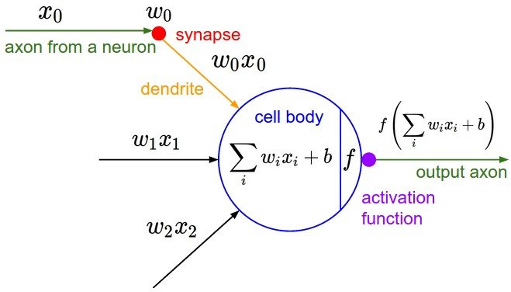


Model: Fully-connected Neural Network Layer
0
$$σ($$
$$)$$
Non-Linearity
Source: An Intro to Spectral Convolution Neural Networks by Dr. Patrick McClure

Slide 12
Reproducibility and Defensibility
Reproducibility (What we do):
Same code + Same data = same results
Clear workflow
Document our assumptions, transformations, and decisions
Your future self (and others) should be able to rerun the analysis without guessing
Defensibility (What we explain):
To our customer / Commander
Why this model?
What assumptions does our method rely on?
What alternatives did we consider?

